Slide 1


Slide 2
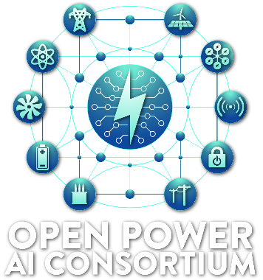
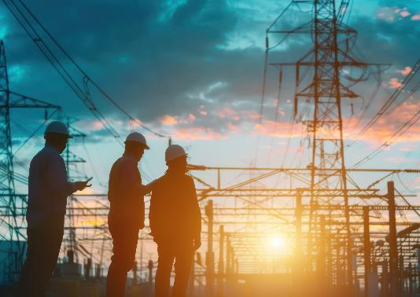






Bringing Enduring Value to the Global Electric Sector
Utilities
National Labs, Academia, & Others
Technology Partners
… and more

Slide 3
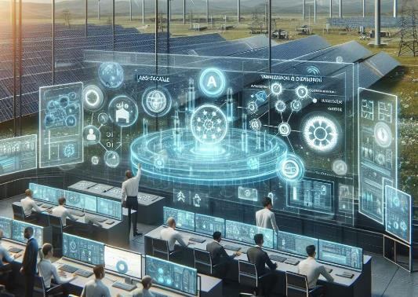
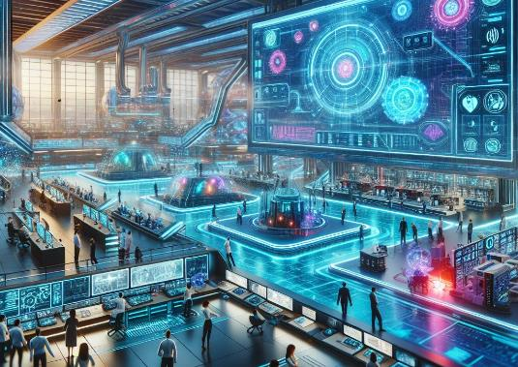
Three Key Pillars of Open Power AI
Collect Data, Develop Libraries & AI Models
AI Sandbox
Implementation and Lessons Learned
Images created with Copilot

Slide 4

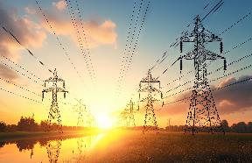
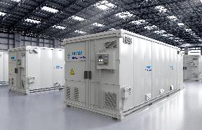
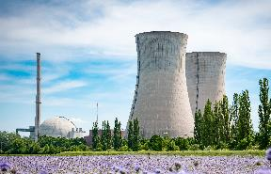
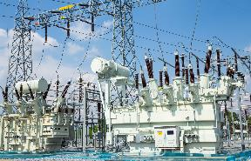
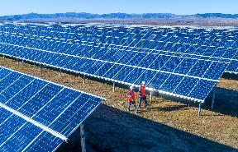

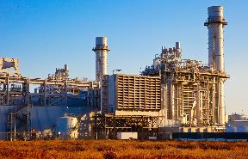
Data is the Fuel for AI
~95% of All Data is Private
EPRI’s Connections are Critical

Slide 5









Powering Global Collaboration and Innovation
Utilities
EPRI
Programs & Network
Nonprofits/
NGOs
Making Electricity
Using Electricity
Tech Companies
Government/
Regulatory Agencies
Moving Electricity
Universities
National Labs

